Slide 2

Honor Thesis Defense:
Towards a Comprehensive AI Teaching Assistant Based on Course Forums
Presenter: Bowen Gu
Advisor: Prof. Prasun Dewan

Slide 3
Towards a Comprehensive AI Teaching Assistant Based on Course Forums
Comprehensive : Multi-functional and multi-task
AI Teaching Assistant : Semi-automatic program that assists instructors
Towards : UI and other parts of the envisioned system are missing

Slide 4
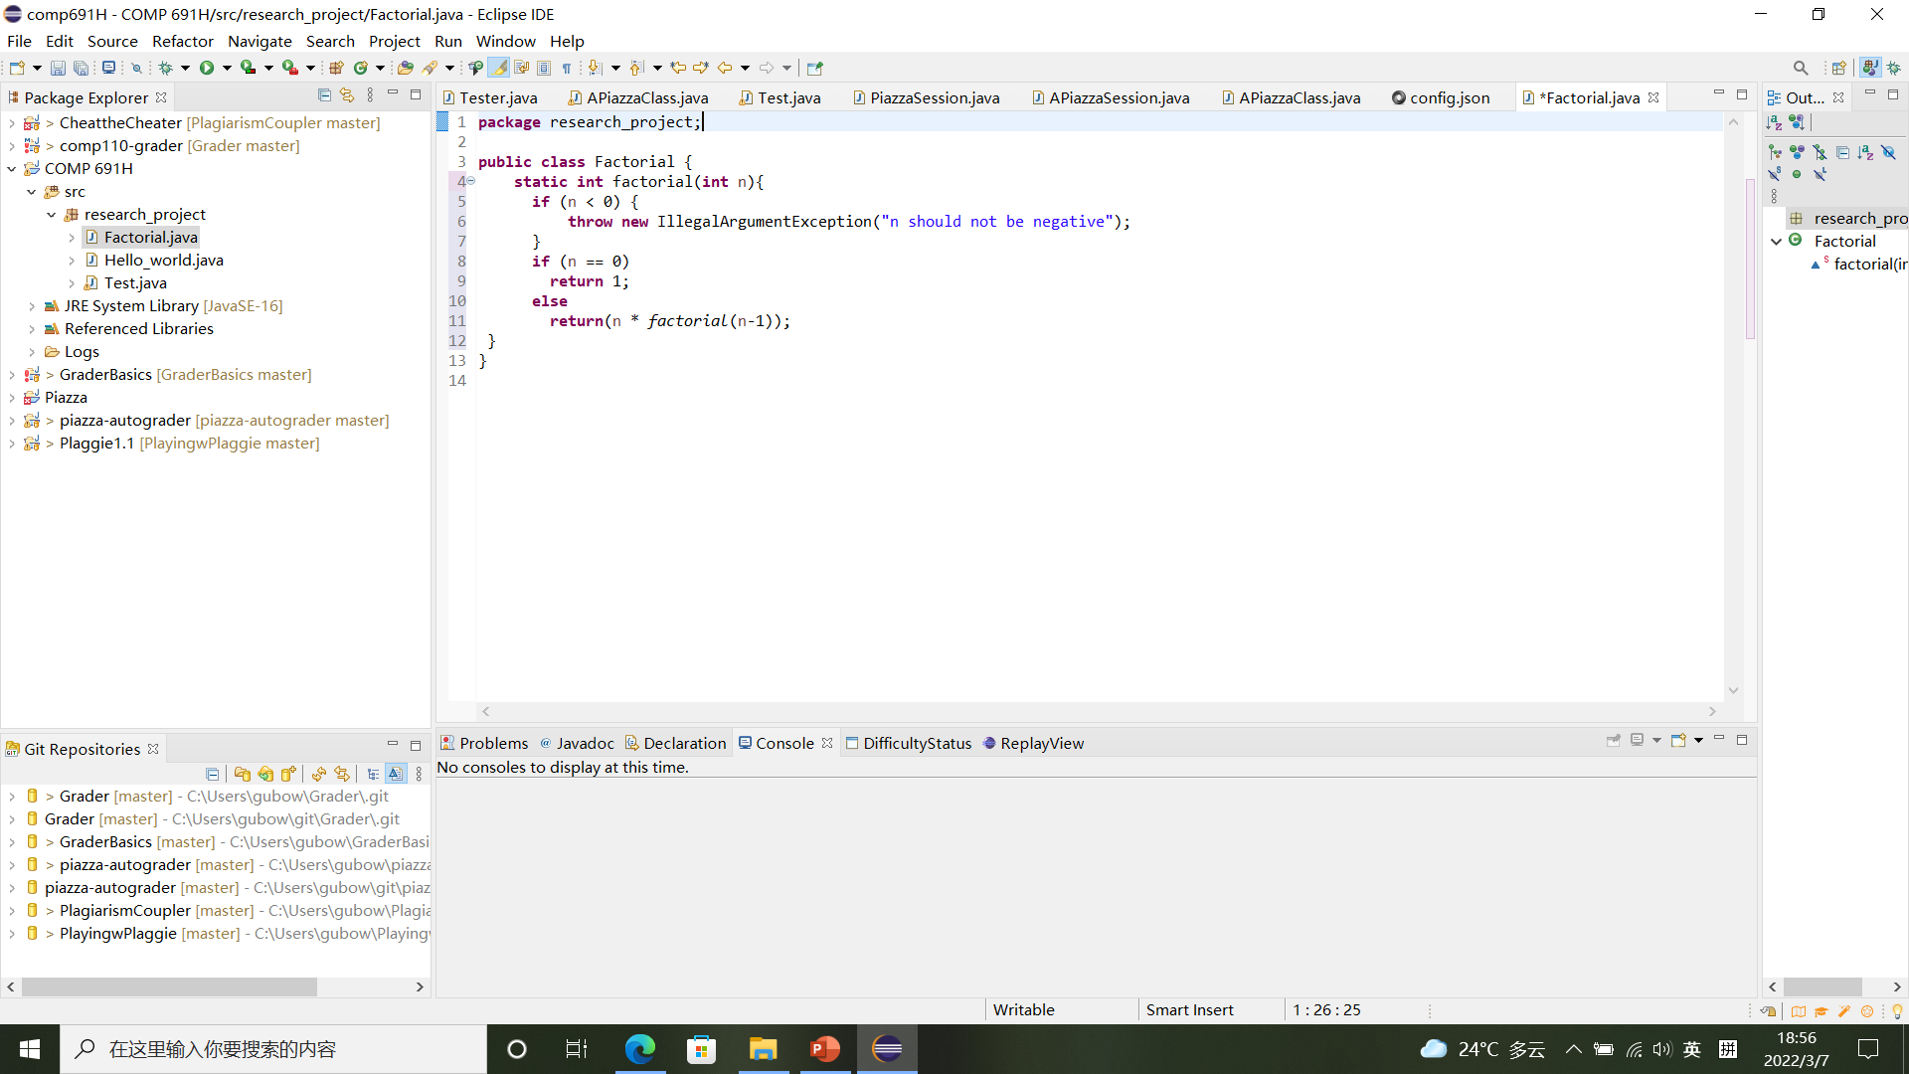
Our Vision (UI Unimplemented)
Example: Java Factorial Function
Assignment: write a factorial function in Java
Input: integer n
Output: integer n!
Instructor Solution Code

Slide 5
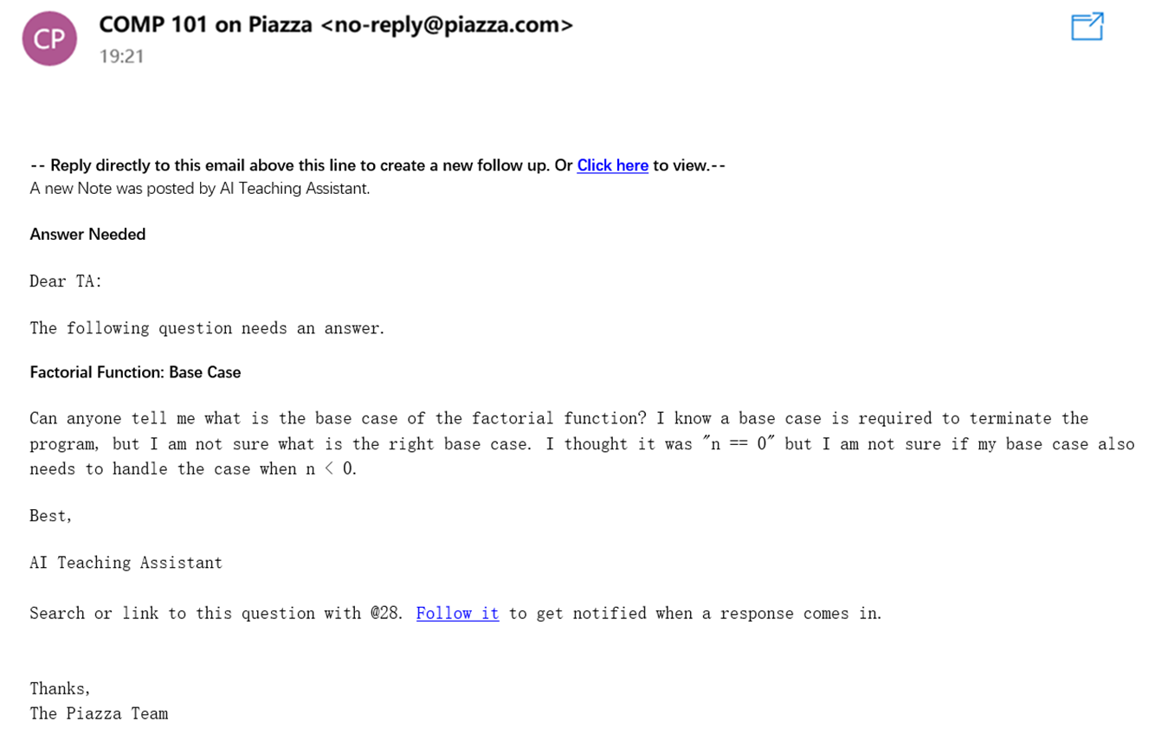
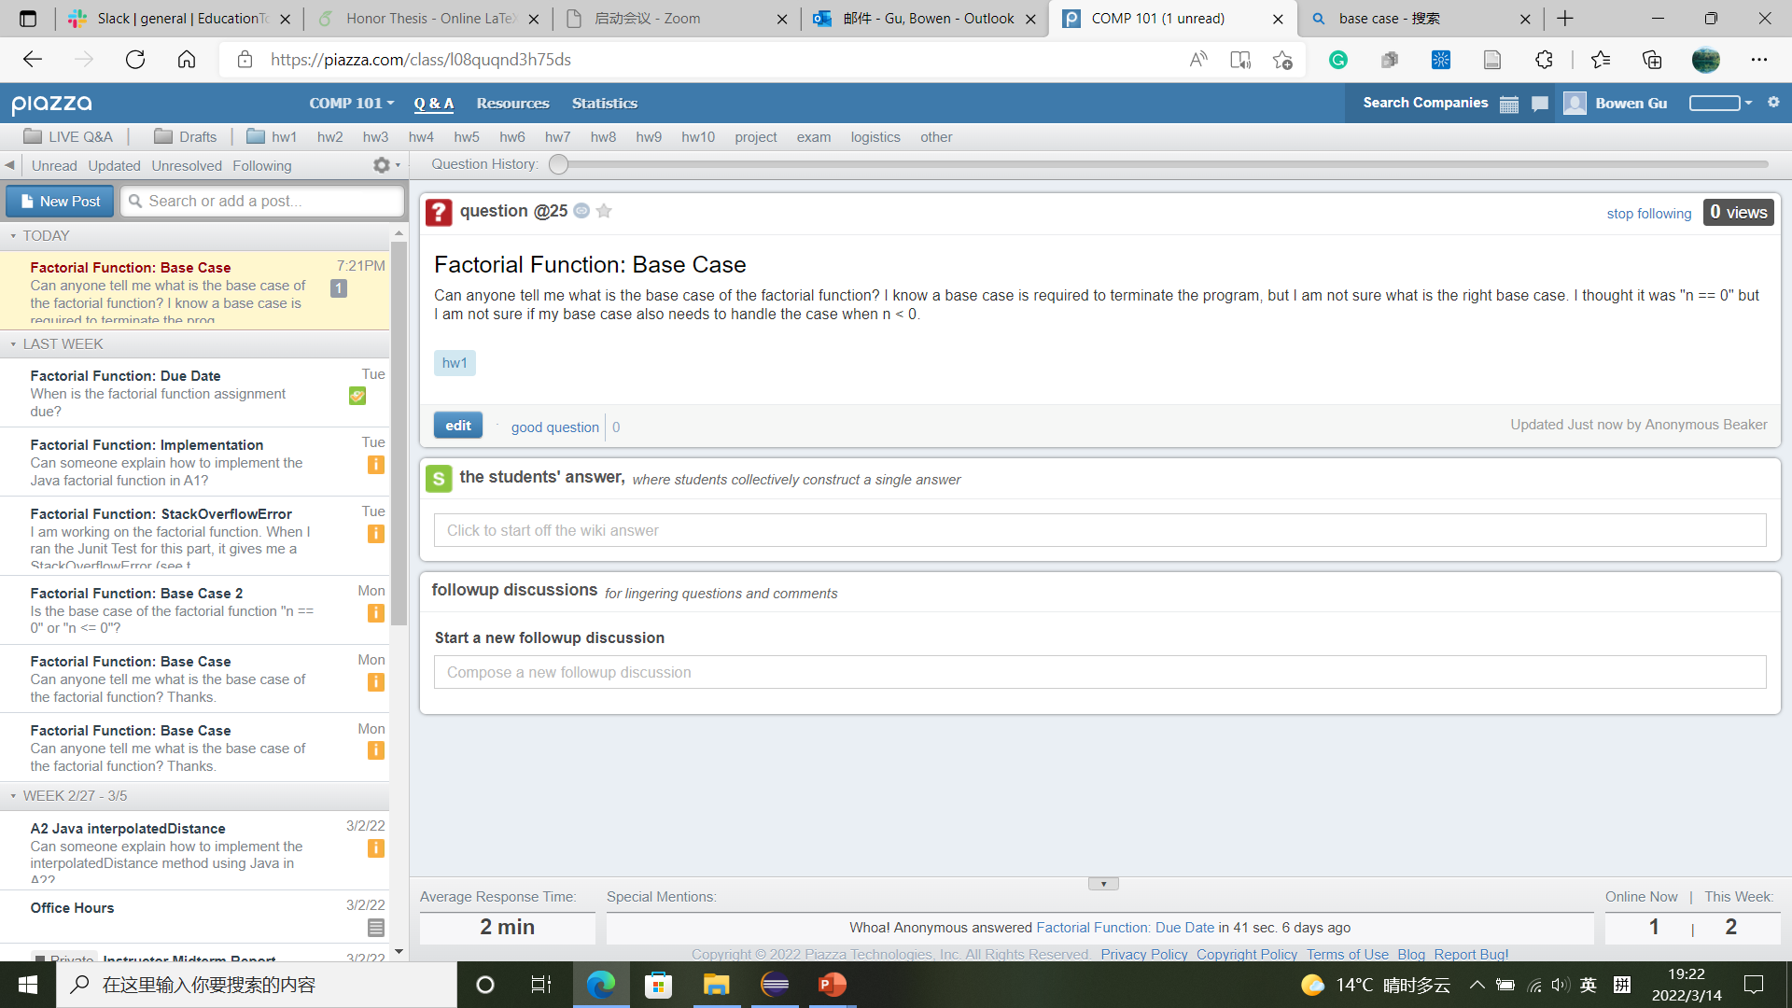
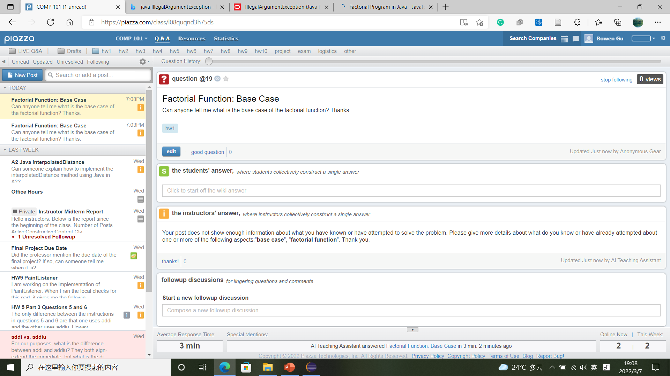
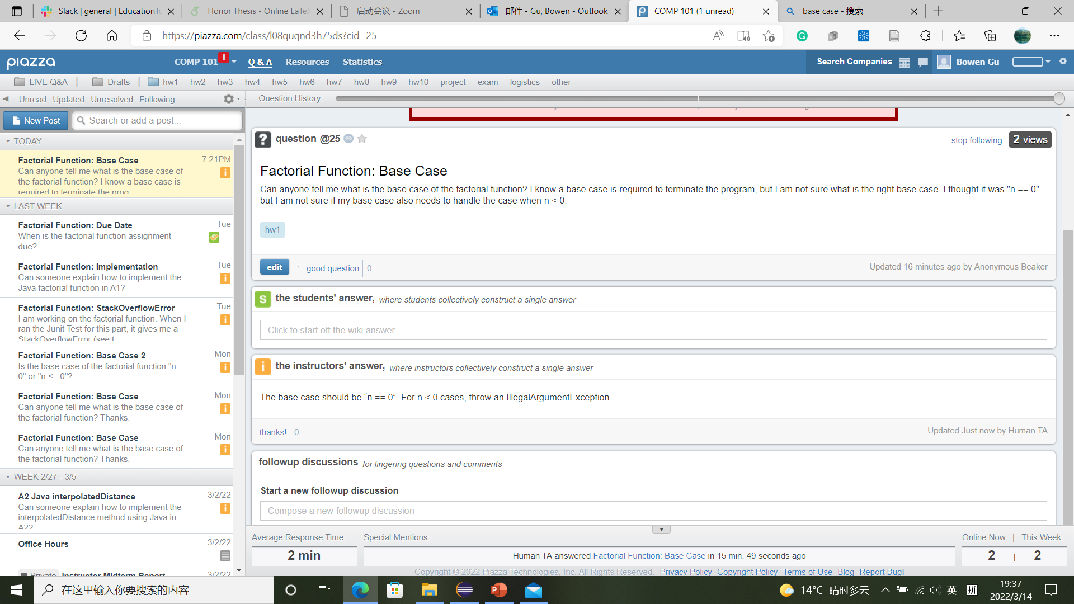
Our Vision (UI Unimplemented)
1. Learning Suggestion
To: The human TA
“Constructive” question, which show knowledge/attempt
“Active” question, which directly asks for help
Constructive questions forward to the human TA
Request more thinking from student
Aspects are specified

Slide 6
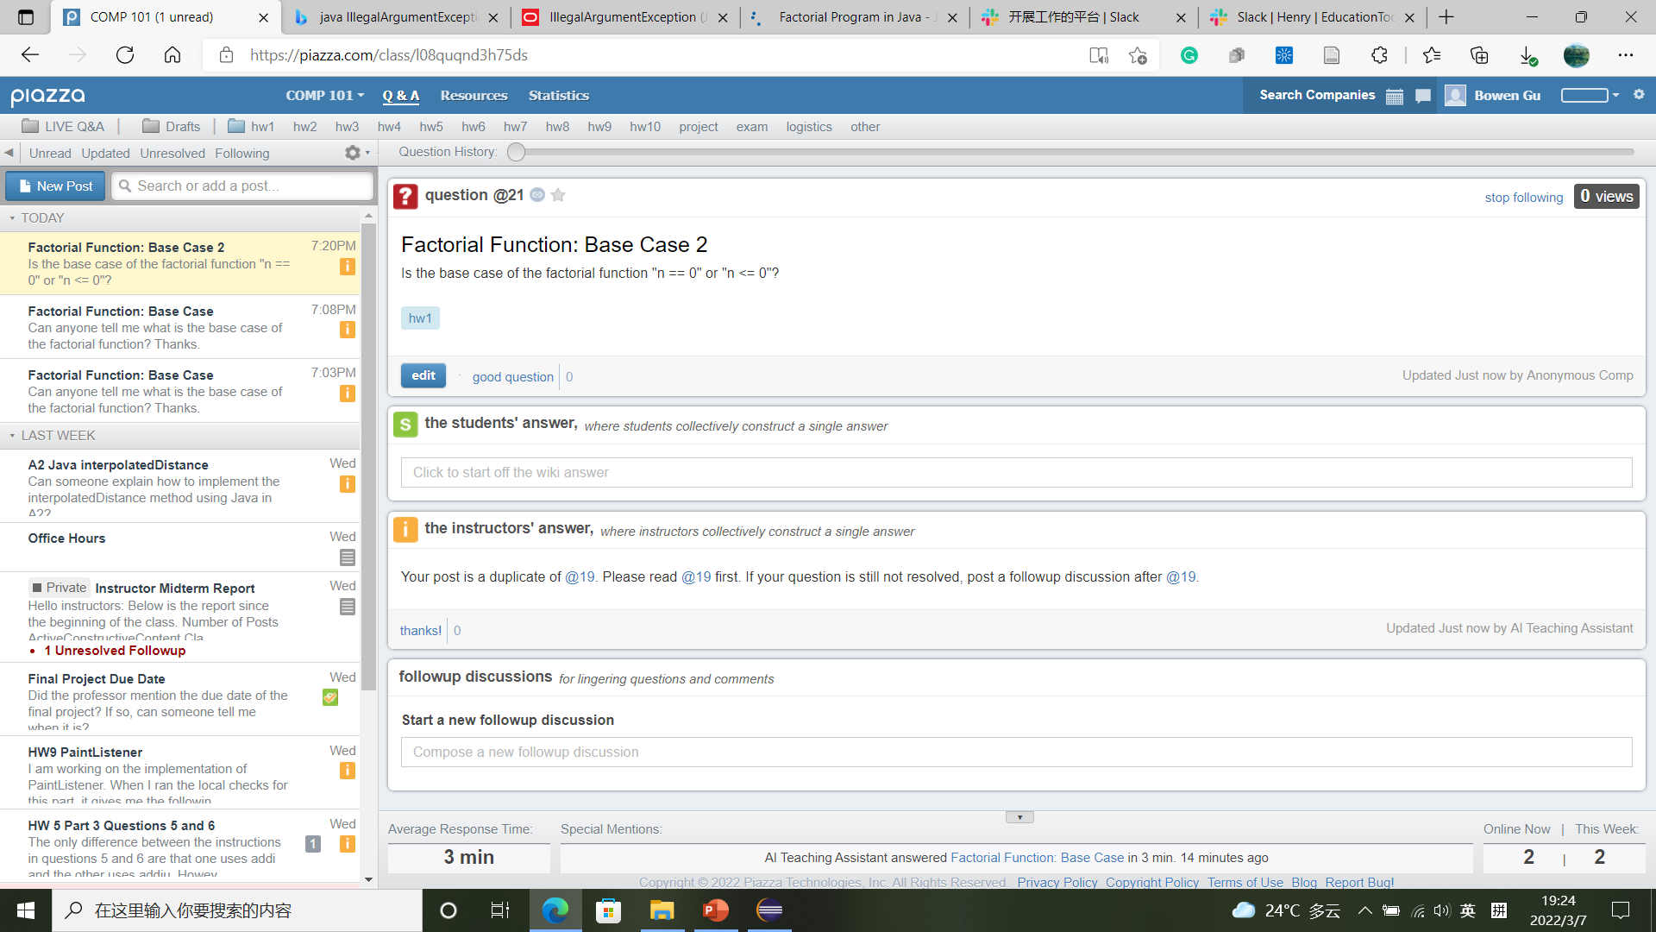
Our Vision (UI Unimplemented)
2. Duplicate Posts Identification
Student post is a duplicate
Point to the similar post

Slide 7
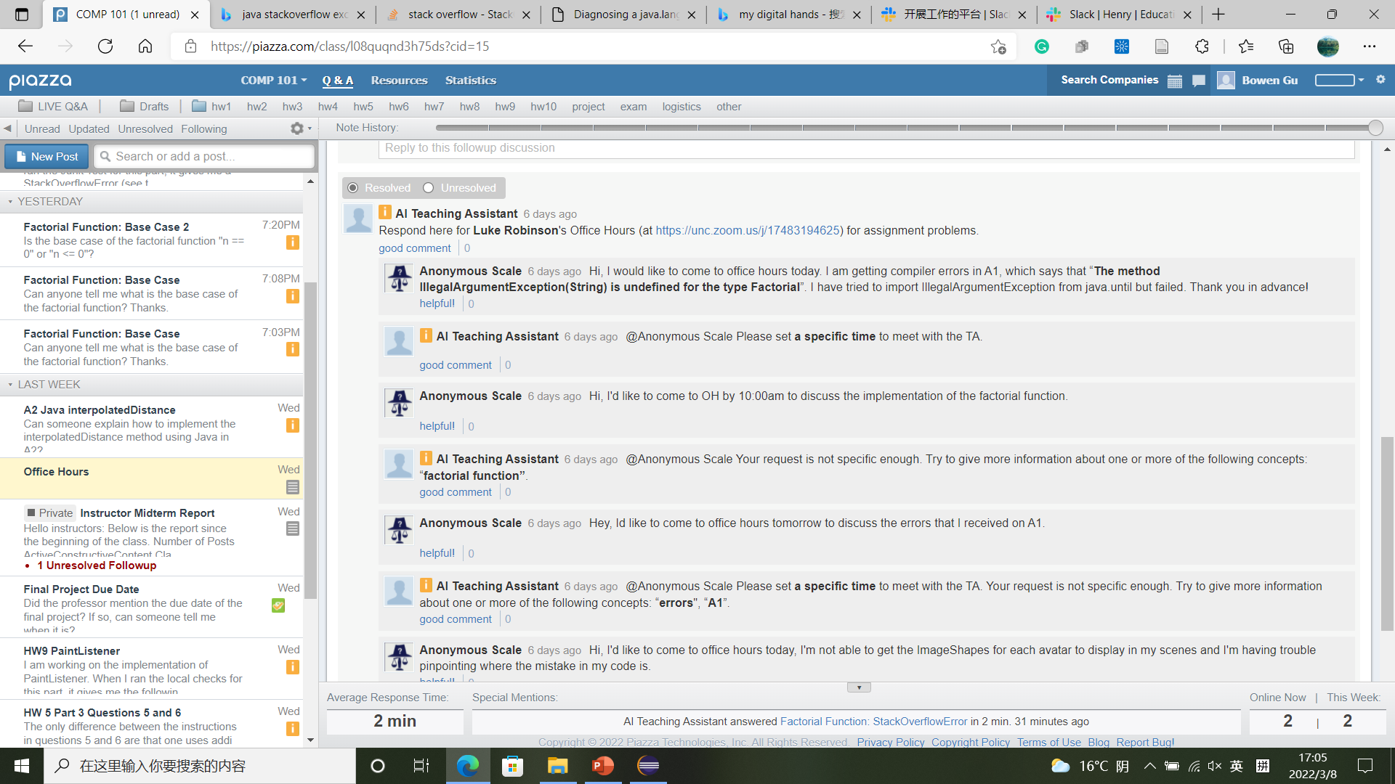


Our Vision (UI Unimplemented)
3. Incomplete Office Hours Requests Identification
Time
Reason
Time
Reason
Time
Reason

Slide 8
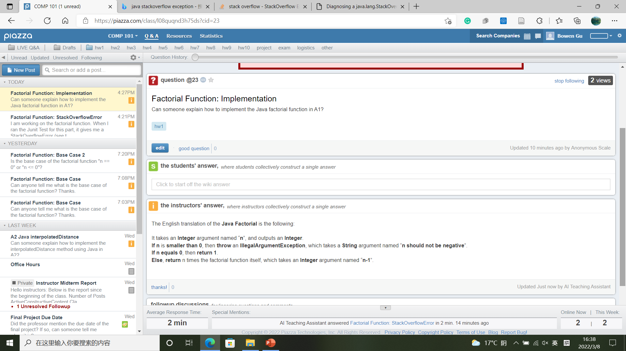
Our Vision (UI Unimplemented)
4. Code Assignment Assist
Student ask about code implementation
Translate the solution code line by line and send to the student

Slide 9




Our Vision (UI Unimplemented)
Before AITA Post the Response
Please confirm the proposed reply
If confirmed → AITA Post on Piazza
If rejected → Instructor edits the reply → AITA Post on Piazza
→
Instructor cancels the reply
AITA can be switched to fully-automatic mode

Slide 10
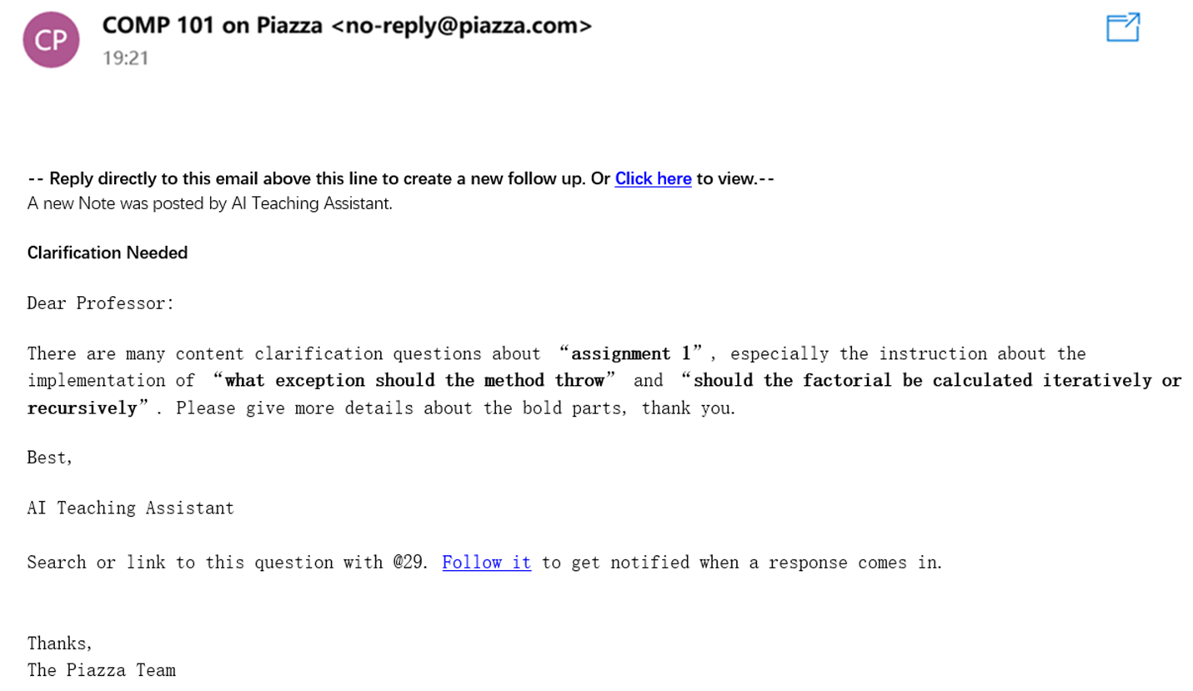
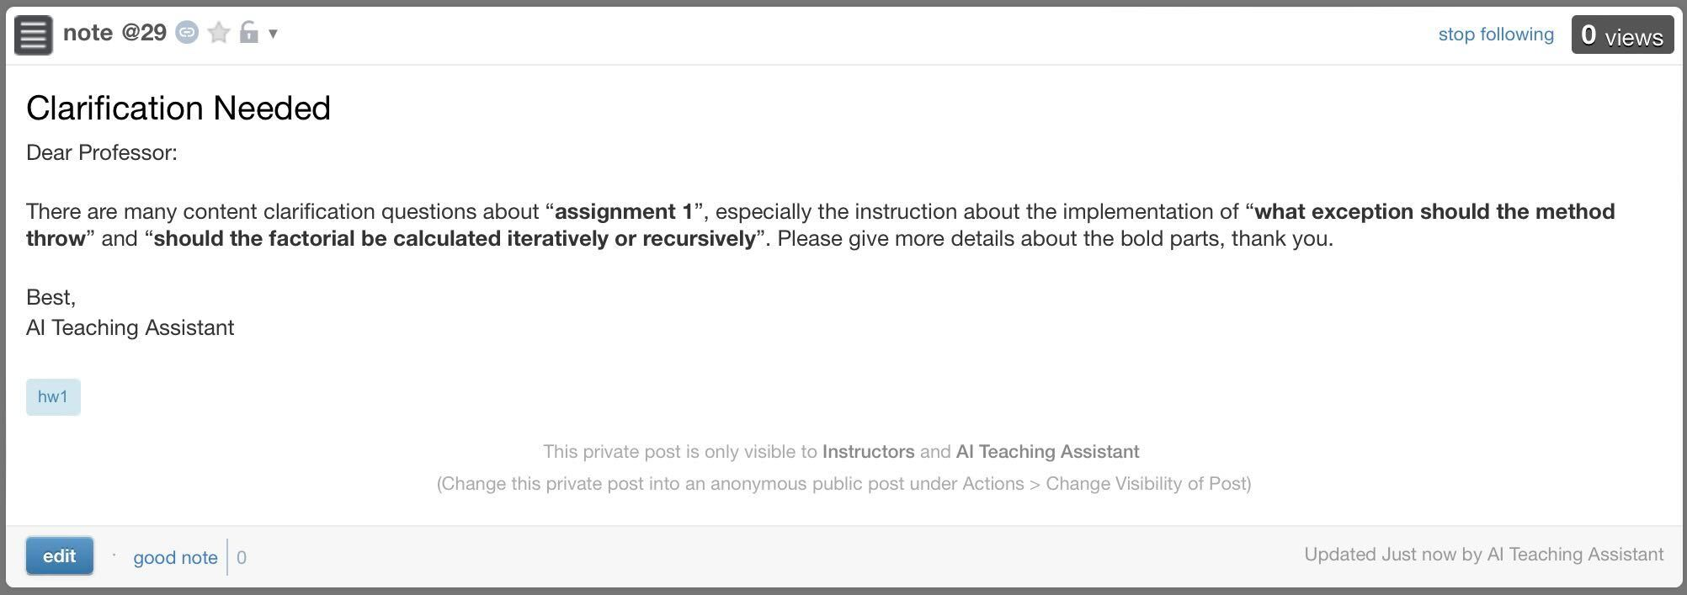
Our Vision (UI Unimplemented)
5. Teaching Suggestion
To: The professor
Many “content clarification” questions
Content clarification questions forward to the professor
Request more clarification from the instructors
Aspects are specified
Instructors only

Slide 11
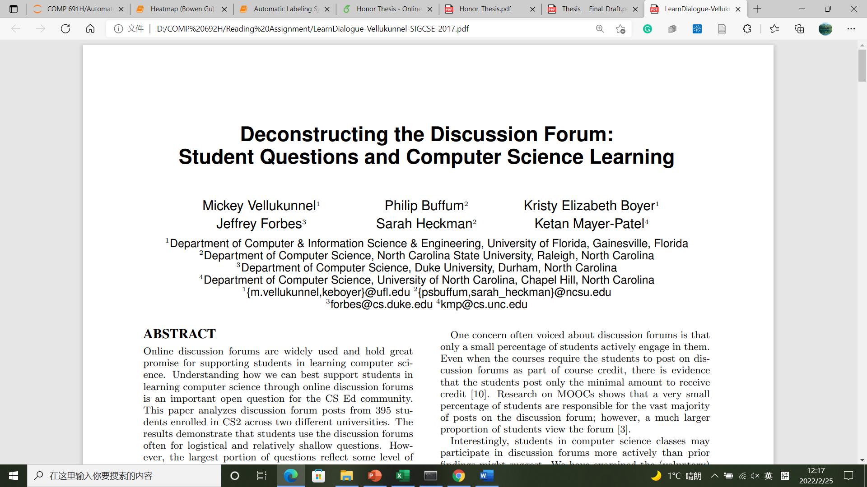
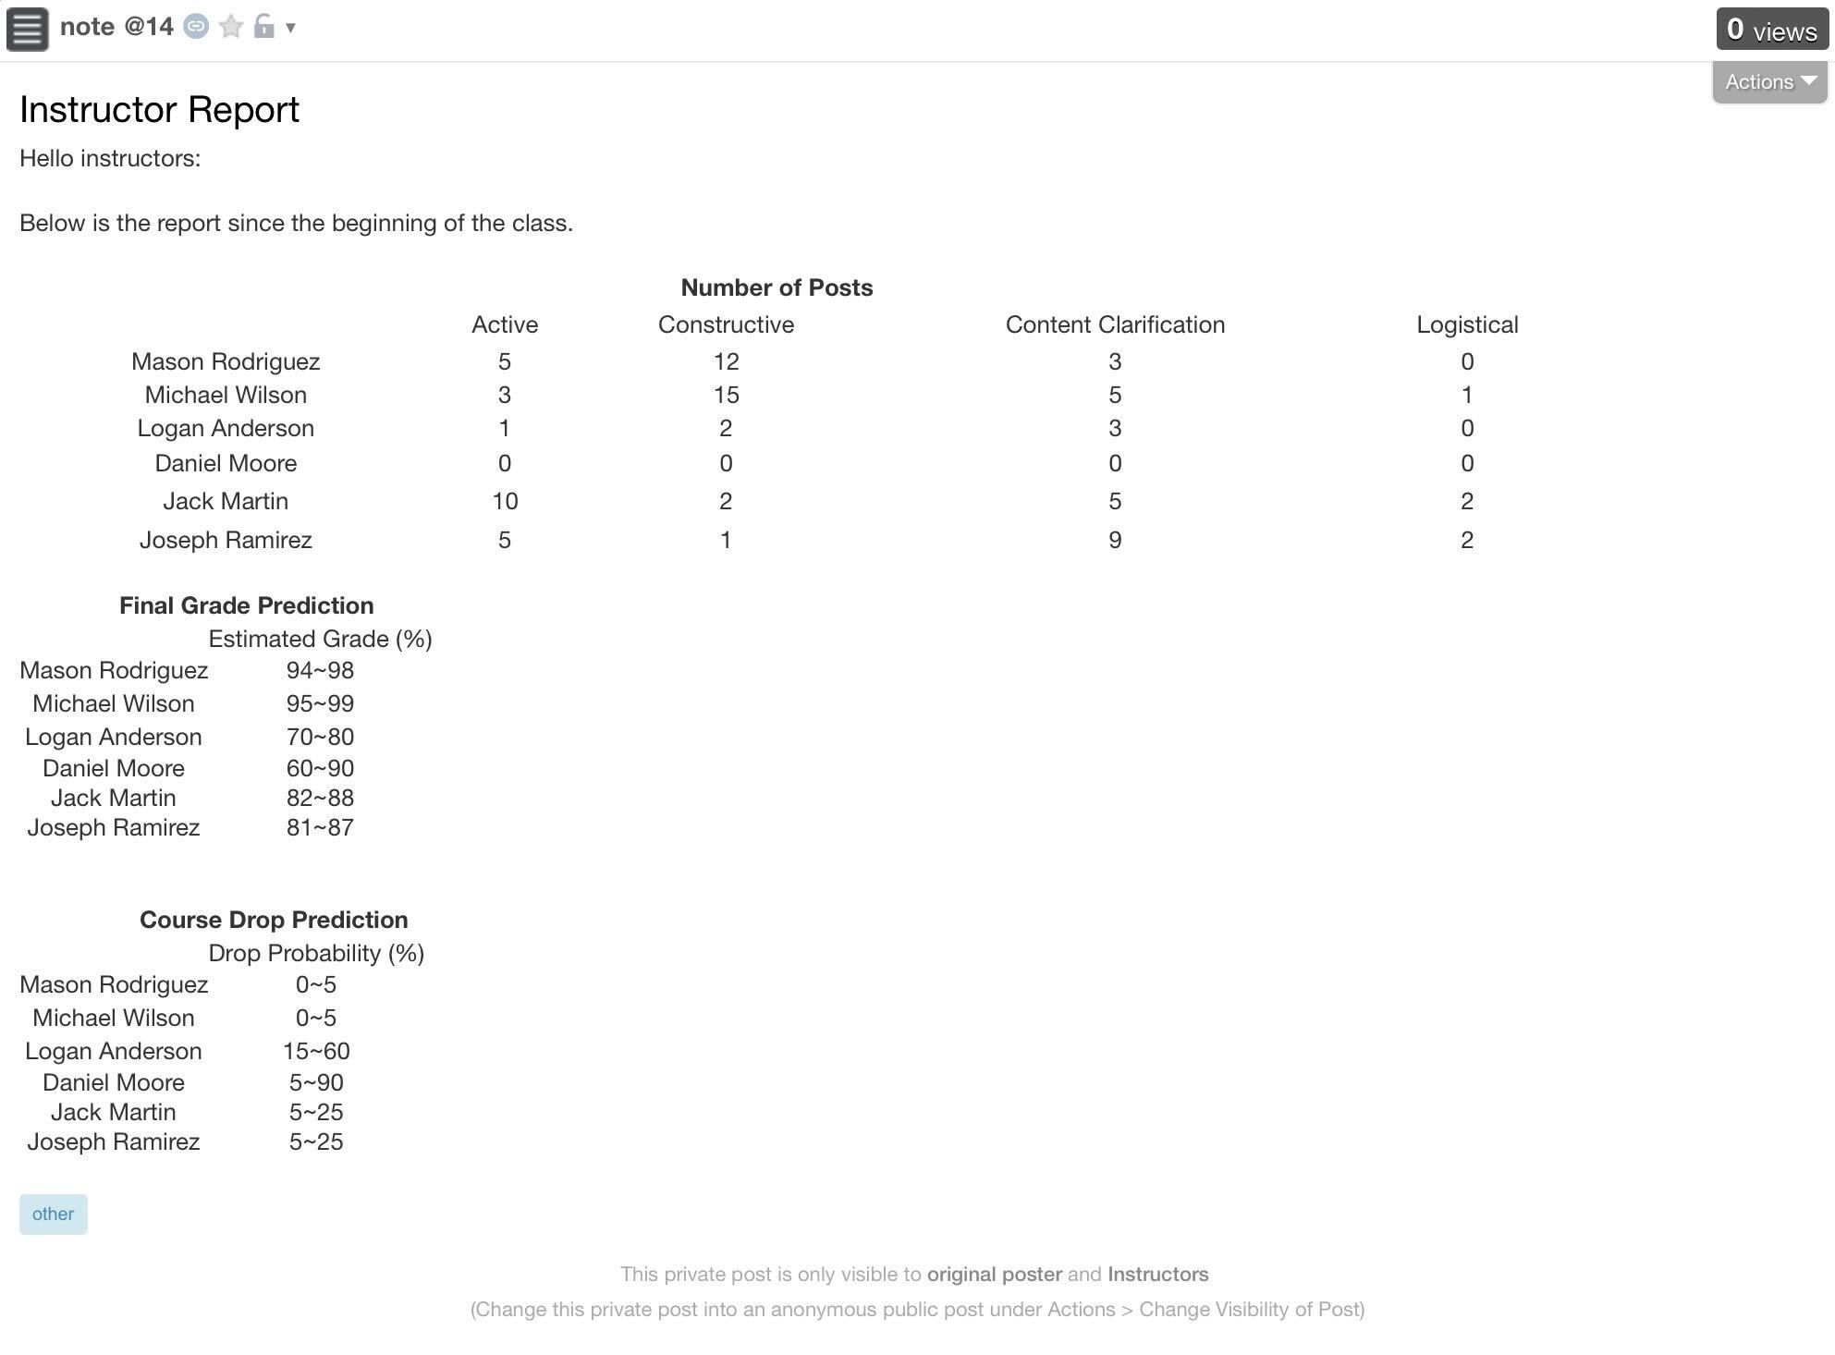
Our Vision (UI Unimplemented)
6. Student Performance Prediction
Post statistics
No. & Type of Questions Asked
Final grade prediction
Final Grades
Course drop prediction
Instructors only
Drop Rate

Slide 12
Overview
1. Learning Suggestion
2. Duplicate Posts Identification
3. Incomplete Office Hours Requests Identification
4. Code Assignment Assist
5. Teaching Suggestion
6. Student Performance Prediction
7. …

Slide 13
Overview
Database
Kernel
AI Teaching Assistant
Connection
UI

Slide 14
Overview
Kernel
A
B
A: Automatic Labeling System
1. Learning Suggestion
Kernel
2. Duplicate Posts Identification
C
D
B: Duplicate Posts Identifier
3. Incomplete Office Hours Requests Identification
4. Code Assignment Assist
5. Teaching Suggestion
C: Incomplete Office Hours
Requests Identifier
Feature Extraction
Prediction Model Set Up
Data Collection
Data Cleaning
Output Predictions
6. Student Performance Prediction
D: Automatic Assignment Assistant

Slide 15
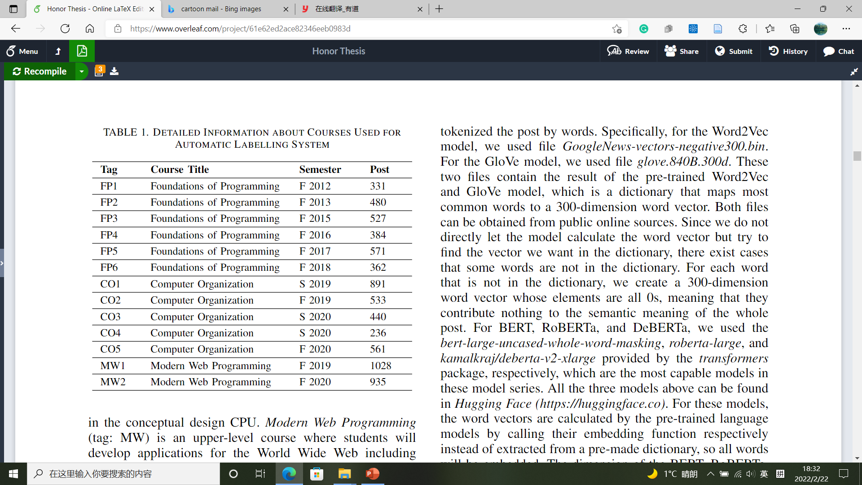
4.1 Automatic Labeling System Methodology
4.1.1 Data Collection
COMP 401
University: UNC-CH
Department: CS
Courses: 13 (6FP + 5CO + 2MW)
Posts: 7,279
COMP 411
COMP 426

Slide 16
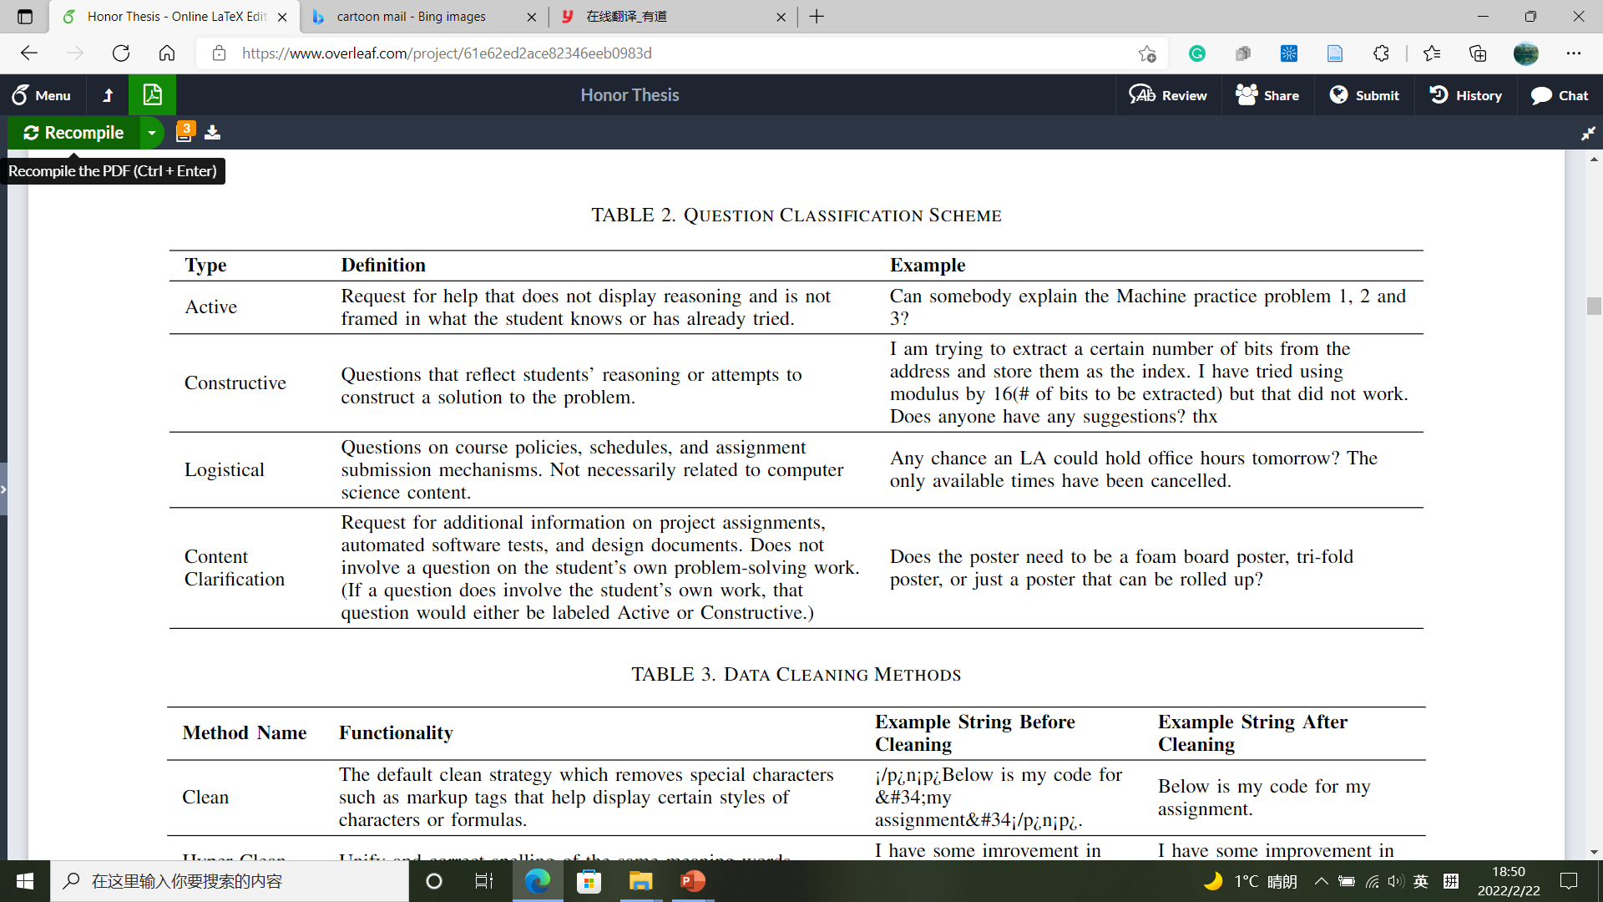
4.1 Automatic Labeling System Methodology
4.1.1 Data Collection
Post + Label

Slide 17
4.1 Automatic Labeling System Methodology
4.1.1 Data Collection
Logistical?
Y
N
Logistical
Student’s own work?
Y
N
Reasoning/Attempt?
Content
Clarification
Y
N
Constructive
Active

Slide 18
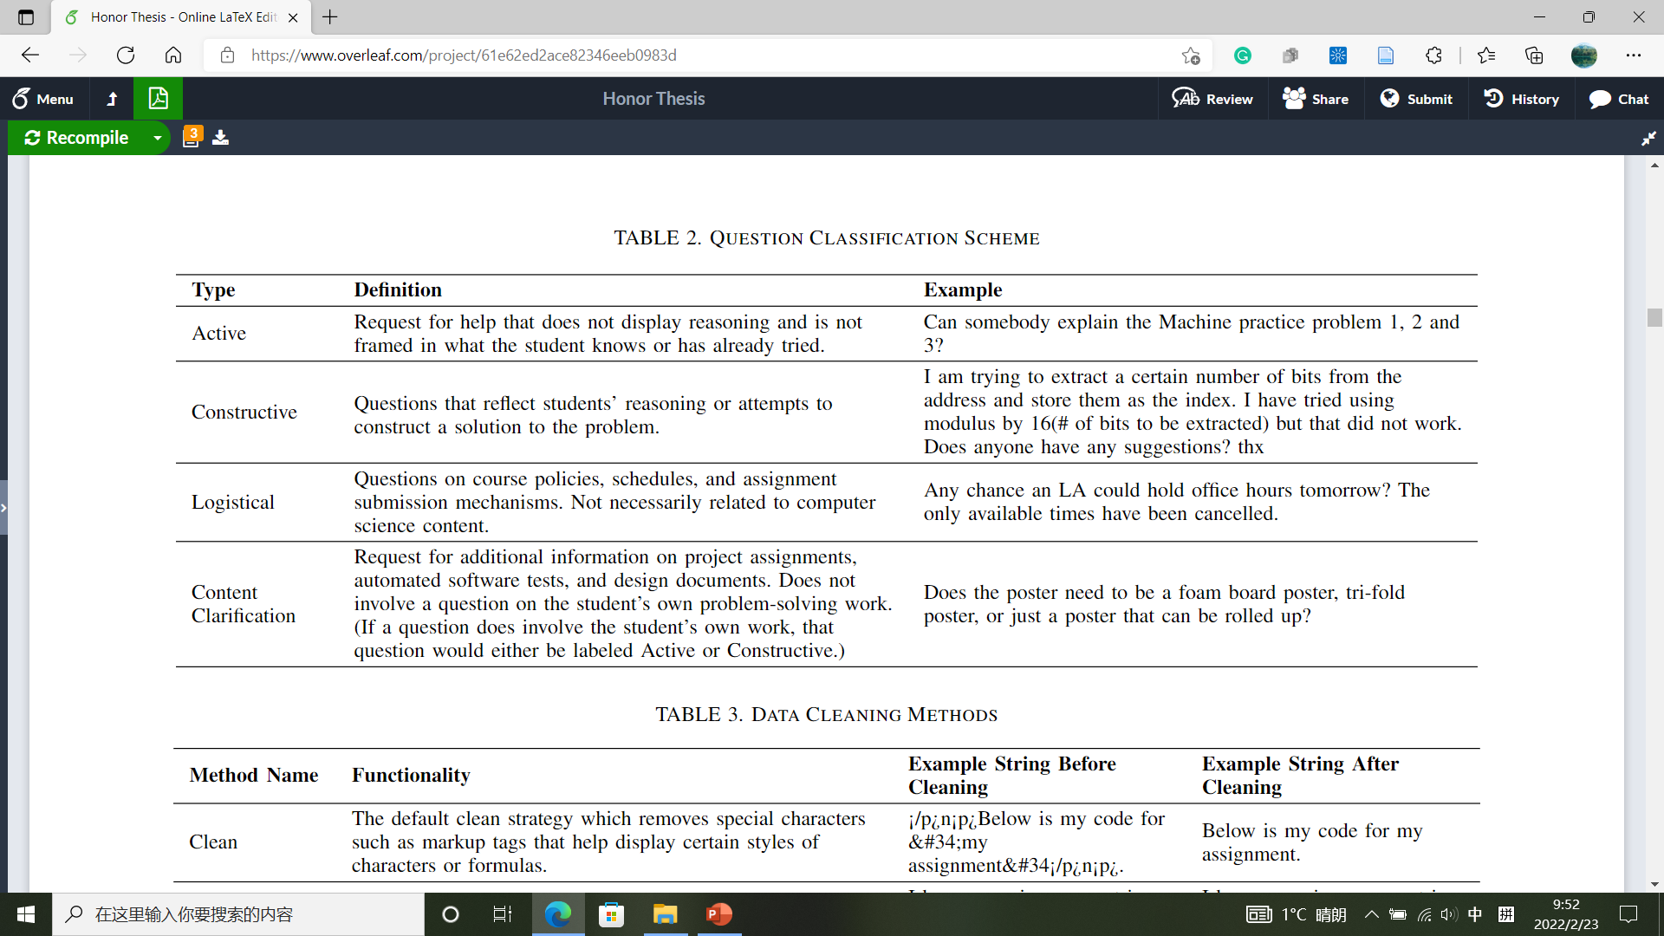
4.1 Automatic Labeling System Methodology
4.1.1 Data Collection
Logistical?
Y
N
Representative posts labeled by
the automatic labelling system
Logistical
Student’s own work?
Y
N
Reasoning/Attempt?
Content
Clarification
Y
N
Constructive
Active

Slide 19
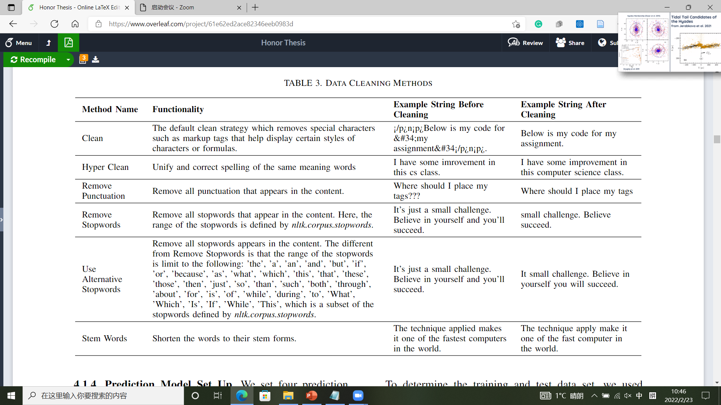
4.1 Automatic Labeling System Methodology
4.1.2 Data Cleaning
Post + Label
Cleaned Post + Label

Slide 20
4.1 Automatic Labeling System Methodology
4.1.2 Data Cleaning
More concise
More data cleaning
Greater information loss
Default ON
Remove special characters
Correct spelling + unify abbr.
ON/OFF
ON
ON
Remove all punctuations
ON/OFF
ON
ON/OFF
Remove stopwords in nltk.corpus.stopwords
ON/OFF
Manually reduced stopwords set
ON
OFF
Shorten words to stems
ON/OFF

Slide 21

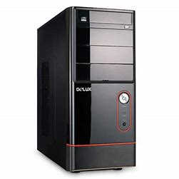
4.1 Automatic Labeling System Methodology
4.1.3 Feature Extraction
Prediction Model
Language Model
Cleaned Post + Label
Machine Learnable Post +
Label

Slide 22
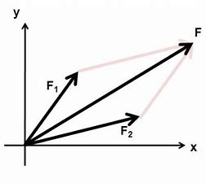

4.1 Automatic Labeling System Methodology
4.1.3 Feature Extraction
Post numerical vector = $Σ(Each word vector)$
Language Model
1 semantic meaning direction
}
Context
Hello
Numerical Vector
[1.0, -0.8, …, 2.1]
N elements (dimensions)
Depend on actual language model
More dimensions
Higher resolution
Better understanding

Slide 23
Language Model
4.1 Automatic Labeling System Methodology
4.1 Automatic Labeling System
4.1.3 Feature Extraction
 | Language Models
Name | Word2Vec | GloVe | BERT | RoBERTa | DeBERTa | GPT-3
Released Year | 2013 | 2014 | 2018 | 2019 | 2021 | 2020
# Parameters (most capable sub-model) | / | / | 340 M | 355 M | 1.5 B | 175 B
Vector Length (most capable sub-model) | 300 | 300 | 1,024 | 1,024 | 1,536 | 12,288
Notes:
See the thesis for language model introductions

Slide 24
4.1 Automatic Labeling System Methodology
4.1.3 Feature Extraction
Numerical Vector 1 + Label
Numerical Vector 2 + Label
Language Model
Numerical Vector 3 + Label
Cleaned Post + Label
Machine Learnable Post +
Label
Numerical Vector 4 + Label
Numerical Vector 5 + Label
Numerical Vector 6 + Label

Slide 25
4.1 Automatic Labeling System Methodology
4.1.4 Prediction Model Set Up
RFC
Results 1
Prediction Model
XGBoost
Results 2
Numerical Vector + Label
CNN
Results
Results 3
LSTM
Results 4
Notes:
See the thesis for prediction model parameter set up

Slide 26

Feature Extraction
Prediction Model Set Up
Data Collection
Data Cleaning
Output Predictions

Slide 27
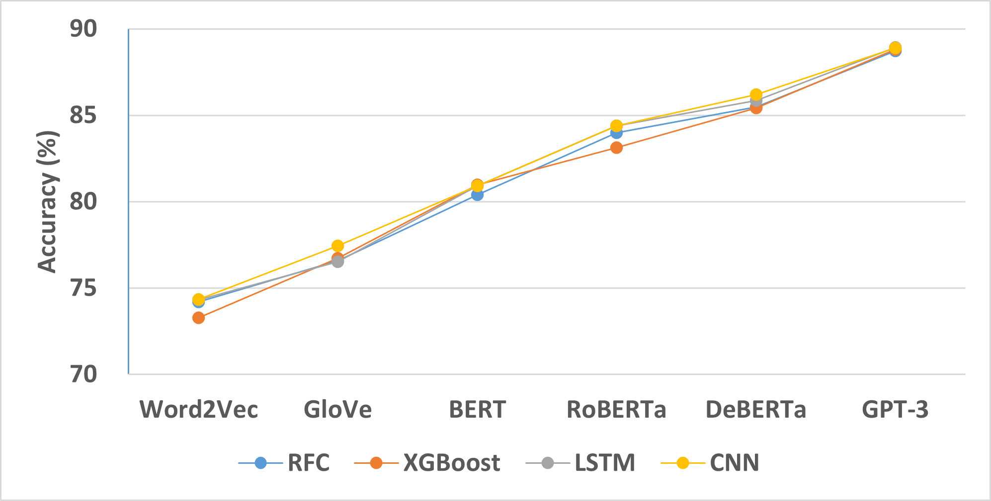
5.1 Automatic Labeling System Results
Model Accuracy (All → All)
Language model:
Increase with capability
Prediction model:
Little difference
CNN slightly better
XGBoost slightly worse
Training Data:
80% of all posts
Test Data:
20% of all posts

Slide 28
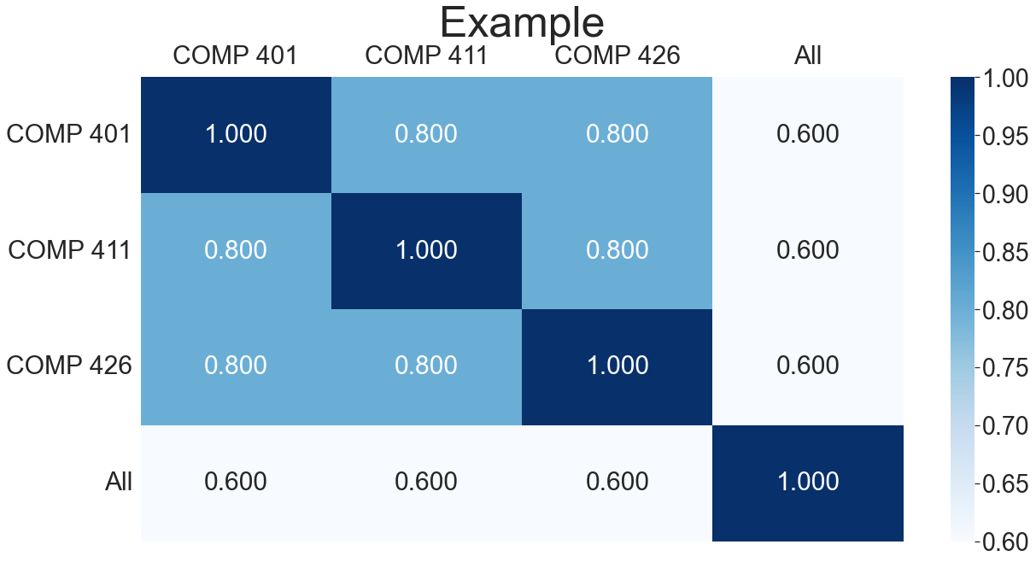
5.1 Automatic Labeling System Results
Heat Map (CNN)
X-axis: Test data
COMP 401
Case 1
Case 2
Case 2
Case 3
Case 2
Case 1
Case 2
Case 3
COMP 411
Y-axis: Training data
Case 2
Case 2
Case 1
Case 3
COMP 426
Case 3
Case 3
Case 3
Case 1
All =
COMP 401
+
COMP 411
+
COMP 426
Case 1: Train = 80% course group posts
Test = 20% course group posts
Example 1: Train = 80% COMP 401 posts
Test = 20% COMP 401 posts
Case 2: Train = 100% course group 1 posts
Test = 100% course group 2 posts
Example 2: Train = 100% COMP 401 posts
Test = 100% COMP 411 posts
Case 3: Non-All = 100% course group posts
All = All posts – non-All group posts
Example 3: Train = 100% COMP 401 posts
Test = 100% COMP 411 + COMP 426 posts
Example 4: Train = 100% COMP 411 + COMP 426 posts
Test = 100% COMP 401 posts

Slide 29
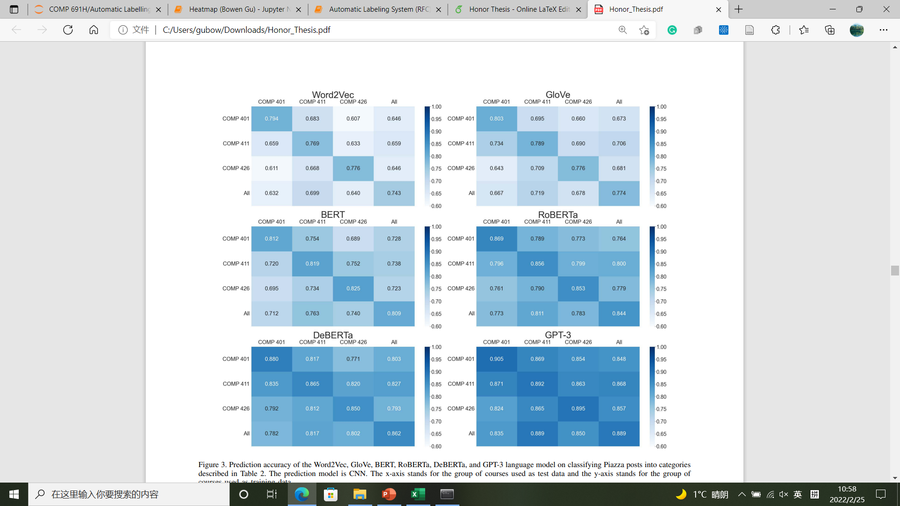
5.1 Automatic Labeling System Results
Heat Map (CNN)
Difference between diagonal &
non-diagonal cells gets smaller
Leading diagonal elements > other elements
COMP 401
COMP 411
COMP 426
All =
COMP 401
+
COMP 411
+
COMP 426
Same courses: closer in style,
questions are similar
More capable language model
→ better semantic understanding
Different courses: differ in style,
questions are different

Slide 30
Kernel
A
B
A: Automatic Labeling System
C
D
B: Duplicate Posts Identifier
Implementation details omitted
Results only
C: Incomplete Office Hours
Requests Identifier
Feature Extraction
Prediction Model Set Up
Data Collection
Data Cleaning
Output Predictions
D: Automatic Assignment Assistant

Slide 31
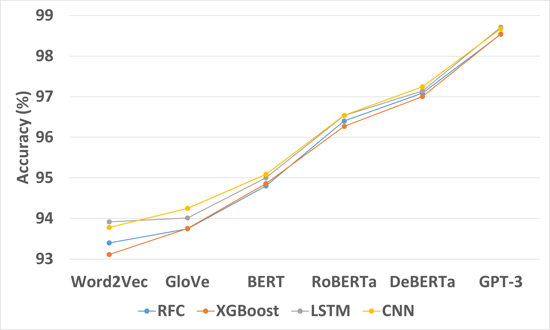
6.1 Conclusion
Duplicate Posts Identifier
Highest Accuracy ≈ 98.5%
Good performance in identifying duplicate Piazza posts
in different semesters and complicated posts

Slide 32
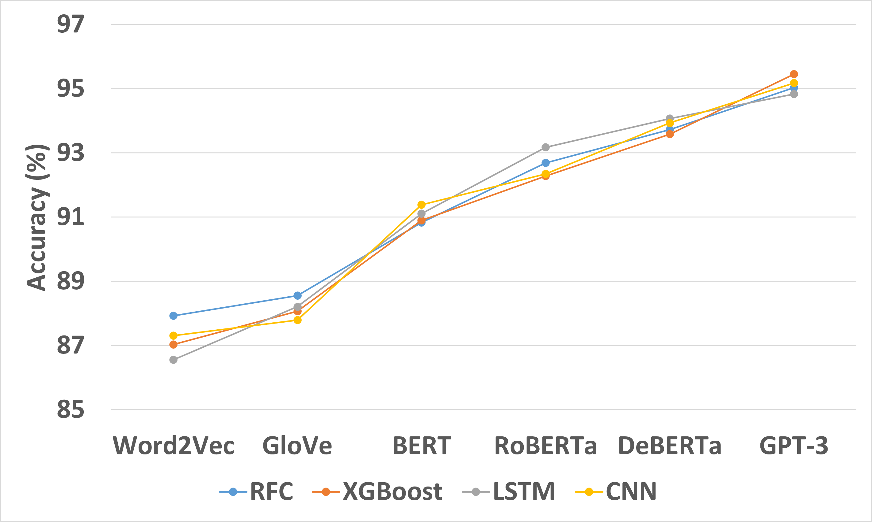
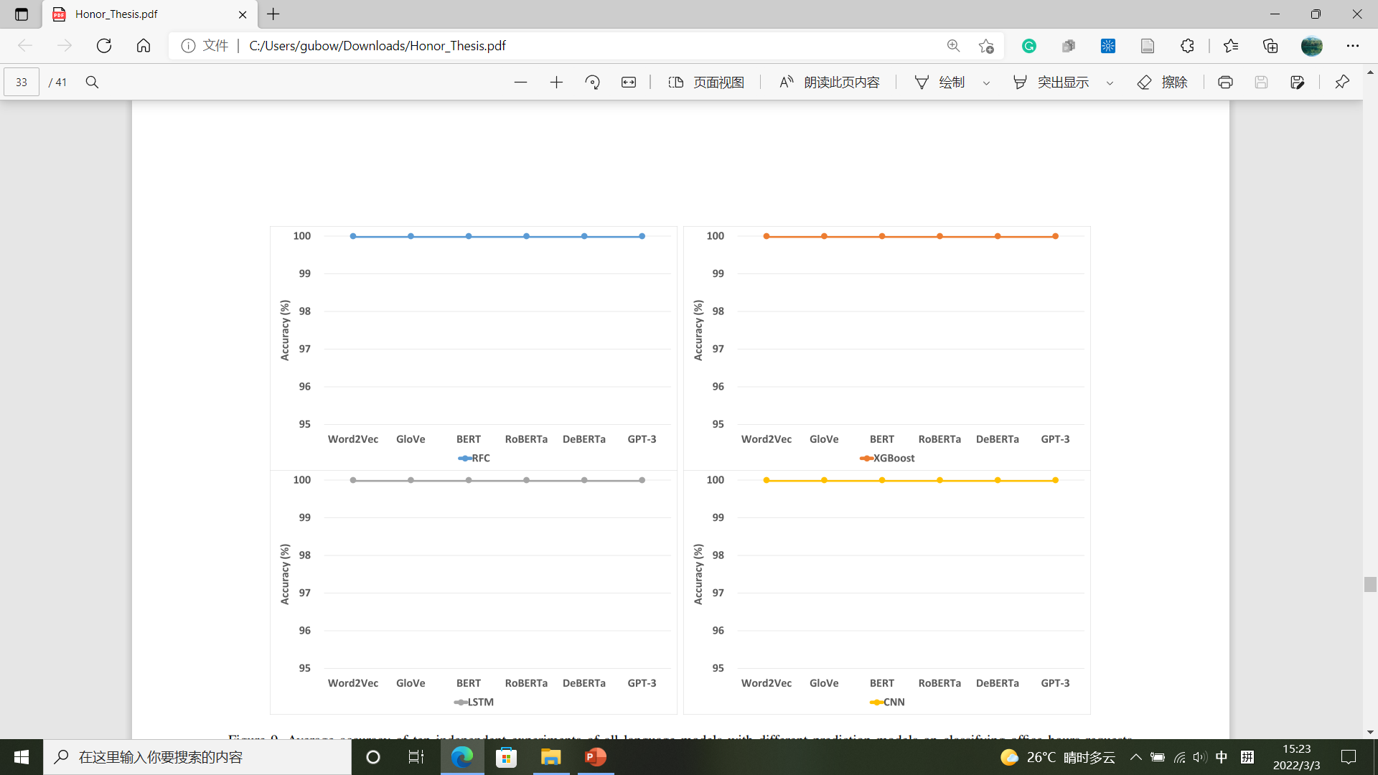
6.1 Conclusion
Incomplete Office Hours Requests Identifier
Highest Accuracy (Time) = 100%
Highest Accuracy (Reason) ≈ 95%
Good performance on
generating automatic reply

Slide 33
6.1 Conclusion
Automatic Assignment Assistant
Translate Function/Method
Student Post
Identify Function/Method
Code Translation
Successfully identify target function/method
Fail to translate target function/method

Slide 34
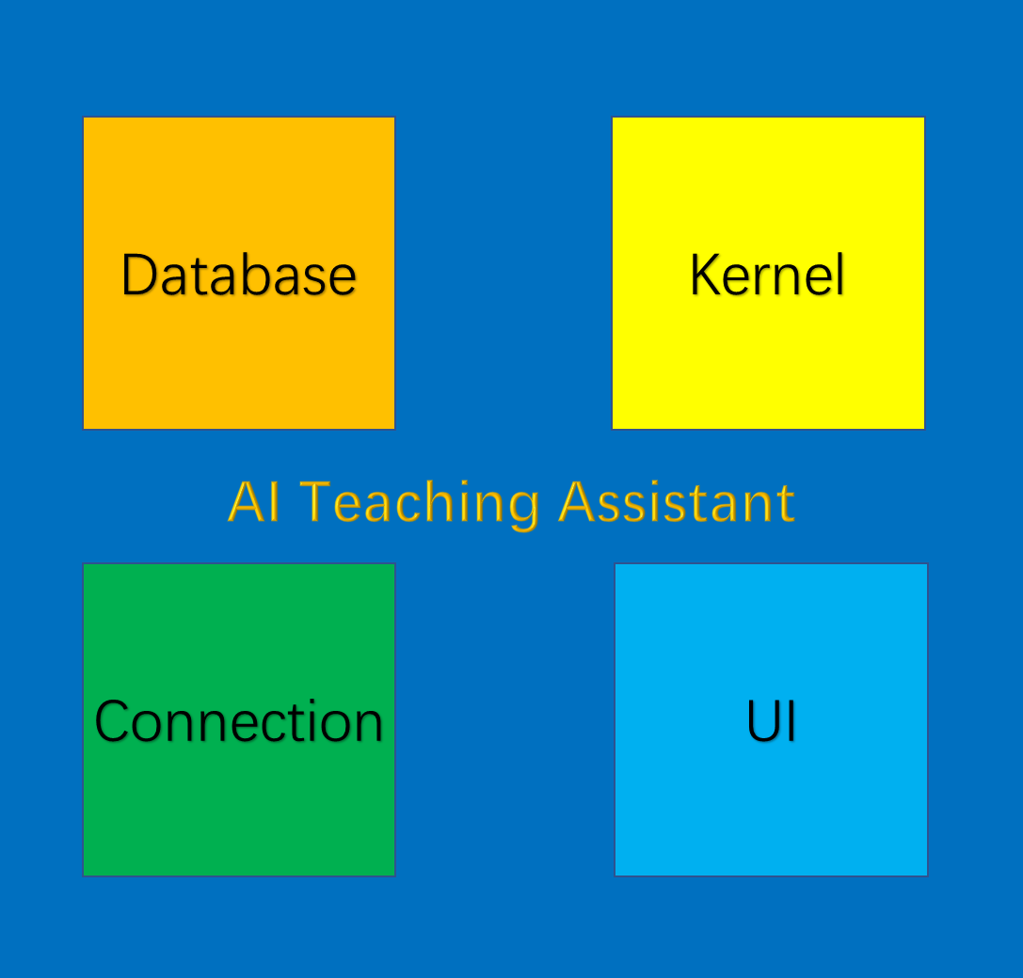
6.2 Future Work
Fine-tune language models
1. Accuracy improvement
Optimize prediction models’ parameters
Combine prediction models
2. Model completeness
1. Learning Suggestion
2. Duplicate Posts Identification
3. Incomplete Office Hours Requests Identification
3. Functionality expansion
4. Code Assignment Assist
5. Teaching Suggestion
6. Student Performance Prediction
7. …
4. More capable code translation model
Codex
GPT-3

Slide 35
Acknowledgments
Thank Hao Wang, the second author of this thesis, for labeling the posts used for training the automatic labeling system and testing the code for the duplicate posts identifier.
Thank Kaizhuo Chen, the third author of this thesis, for labelling the posts used for training the automatic labeling system and the office hours requests used for training the incomplete office hours requests identifier.
Thank Dr. Prasun Dewan, the advisor of this program, for offering precious guidance and resources.
Thank Dr. John Majikes, the second reader, for reviewing the thesis.

Slide 36
References
1. Do, J., Dynamic Tagging of Educational Forum PostsUsing NLP Post Embeddings, 2021.
2. Li, Y., Yang, T., Srinivasan, S., Word Embedding for Understanding Natural Language: A Survey, 2018.
3. Devlin, J., Chang, M., Lee, K., Toutanova, K., BERT: Pre-training of Deep Bidirectional Transformers for Language Understanding, 2019.
4. He, P., Liu, X., Gao, J, Chen, W., DeBERTa: Decoding-enhanced BERT with Disentangled Attention, 2021.
5. He, P., Gao, J, Chen, W., DeBERTaV3: Improving DeBERTa using ELECTRA-Style Pre-Training with Gradient-Disentangled Embedding Sharing, 2021.
6. Pennington, J., Socher, R., Manning, C., GloVe: Global Vectors for Word Representation, 2014.
7. Liu, Y., Ott, M., Goyal, N., Du, J., Joshi, M., Chen, D., Levy, O., Lewis, M., Zettlemoyer, L., Stoyanov, V., RoBERTa: A Robustly Optimized BERT Pretraining Approach, 2019.
8. Goldberg, Y., Levy, O., word2vec Explained: deriving Mikolov et al.'s negative-sampling word-embedding method, 2014.
9. Gardner, M., Grus, J., Neumann, M., Tafjord, O., Dasigi, P., Liu, N., Peters, M, Schmitz, M., Zettlemoyer, L., AllenNLP: A Deep Semantic Natural Language Processing Platform, 2018.
10. Zhu, H., Paschalidis, I., Tahmasebi, A., Clinical Concept Extraction with Contextual Word Embedding, 2018.
11. Akbik, A., Bergmann, T., Blythe, D., Rasul, K., Schweter, S., Vollgraf, R., FLAIR: An Easy-to-Use Framework for State-of-the-Art NLP, 2019.
12. Tomas, M., Kai, C., Greg, C., Jeffrey, D., Efficient Estimation of Word Representations in Vector Space, 2013.
13. Tomas, M., Ilya, s., Kai, C., Greg, C., Jeffrey, D., Distributed Representations of Words and Phrases and their Compositionality, 2013.
14. Mnih, A., Hinton, G., Three new graphical models for statistical language modelling, 2007.
15. Koeman, J., Rea, W., How Does Latent Semantic Analysis Work? A Visualisation Approach, 2014.
16. Radford, A., Narasimhan, K., Salimans, T., Sutskever, I., Improving Language Understanding by Generative Pre-Training, 2018.
17. Wang, A., Pruksachatkun, Y., Nangia, N., Singh, A., Michael, J., Hill, F., Levy, O., Bowman, S., SuperGLUE: A Stickier Benchmark for General-Purpose Language Understanding Systems, 2020.
18. Dayhoff, J., Neural network architectures: an introduction, 1990.
19. Dhillon, A., Verma, G., Convolutional neural network: a review of models, methodologies and applications to object detection, 2020.
20. Olien, L., Bélair, J., Bifurcations, stability, and monotonicity properties of a delayed neural network model, 1997.
21. Lipton, Z., Berkowitz, J., Elkan, C., A Critical Review of Recurrent Neural Networks for Sequence Learning, 2015.
22. Yu, Y., Si, X., Hu, C., Zhang, J., A Review of Recurrent Neural Networks: LSTM Cells and Network Architectures, 2019.
23. Hochreiter, S., Schmidhuber, J., Long Short-Term Memory, 1997.
24. Floridi, L., Chiriatti, M., GPT-3: Its Nature, Scope, Limits, and Consequences, 2020.
25. Dale, R., GPT-3: What’s it good for?, 2021.
26. Radford, A., Wu, J., Child, R., Luan, D., Amodei, D., Sutskever, I., Language Models are Unsupervised Multitask Learners, 2019.
27. Tom B., B., Mann, B., Ryder, N., Subbiah, M., Kaplan, J., Dhariwal, P., Neelakantan, A. et al, Language models are few-shot learners, 2020.
28. Vaswani, A., Shazeer, N., Parmar, N., Uszkoreit, J., Jones, L., Gomez, A., Kaiser, L., Polosukhin, I., Attention is All you Need, 2017.
29. Rajeswaran, A., Finn, C., Kakade, S., Levine, S., Meta-Learning with Implicit Gradients, 2019.
30. Finn, C., Abbeel, P., Levine, S., Model-Agnostic Meta-Learning for Fast Adaptation of Deep Networks, 2017.
31. Chen, M., Tworek, J., Jun, H., Yuan, Q., Pinto, H. et al, Evaluating Large Language Models Trained on Code, 2021.
32. Vellukunnel, M., Buffum, P., Boyer, K., Forbes, J., Heckman, S., Mayer-Patel, K. et al, Deconstructing the Discussion Forum: Student Questions and Computer Science Learning, 2017.
33. Chaturvedi, S., Goldwasser, D., Daumé III, H., Predicting Instructor's Intervention in MOOC forums, 2014.
34. Zhang, W., Sheng, Q., Lau, J., Abebe, E., Detecting Duplicate Posts in Programming QA Communities via Latent Semantics and Association Rules, 2017.
35. Ahasanuzzaman, M., Asaduzzaman, M., Roy, C., Schneider, K., Mining Duplicate Questions of Stack Overflow, 2016.
36. Hindle, A., Barr, E., Gabel, M., Su, Z., Devanbu, P., On the naturalness of software, 2016.
37. Ray, B., Hellendoorn, V., Godhane, S., Tu, Z., Bacchelli, A., Devanbu, P., On the ``Naturalness" of Buggy Code, 2016.
38. Bansal, A., Haque, S., McMillan, C., Project-Level Encoding for Neural Source Code Summarization of Subroutines, 2021.
39. Haque, S., LeClair, A., Wu, L., McMillan, C., Improved Automatic Summarization of Subroutines via Attention to File Context, 2020.
40. LeClair, A., Haque, S., Wu, L., McMillan, C., Improved Code Summarization via a Graph Neural Network, 2020.
41. Ahmad, W., Chakraborty, S., Ray, B., Chang, K., A Transformer-based Approach for Source Code Summarization, 2020.
42. Chen, T., Guestrin, C., XGBoost: A Scalable Tree Boosting System, 2016.
43. Swain, P., Hauska, H., The decision tree classifier: Design and potential, 1977.
44. Liaw, A., Wiener, M., Classiﬁcation and Regression by randomForest, 2002.
45. Sagi, O., Rokach, L., Ensemble learning: A survey, 2018.
46. Lewis, R., An Introduction to Classification and Regression Tree (CART) Analysis, 2000.

